Slide 1


UNIVERSITY INSTITUTE OF TOURISM AND HOSPITALITY MANAGEMENT
DEPARTMENT-AIRLINES
Subject Name- Airport Terminal Operations
Code- 23AAP-111/23TTP-111
Faculty name:
DISCOVER . LEARN . EMPOWER

Slide 2
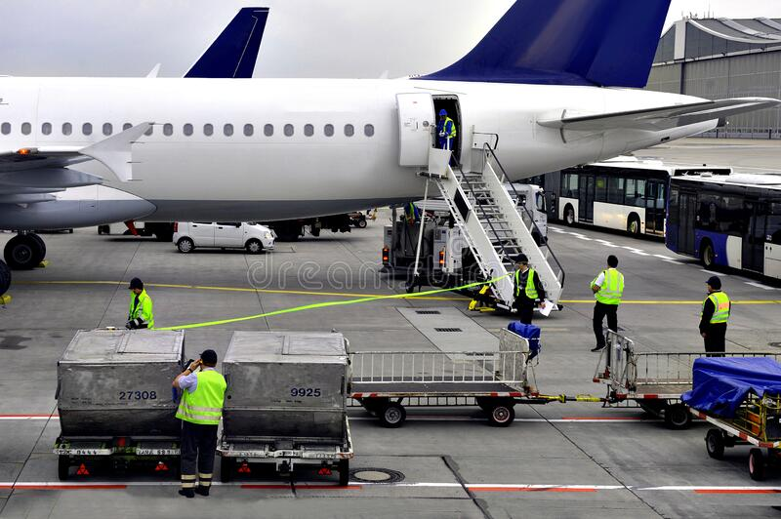
Course Outcomes
CO No | Statement | Performance Indicator | Student Outcome Indicator (ABET) | Level of Learning (Highest BT Level) | Target Attainment
CO1 | Applying skills in coordinating and managing the various components of Airport Terminal Operations, including passenger Processing, Baggage handling and Airfield Operations. | 1.1.1,1.1.3, 1.2.2, 1.2.3 |  | 3 | 70%
CO2 | Analyzing the Safety and security Protocols, including emergency planning and response procedure, and the ability to implement them in a real -World Setting. | 6.1.1,6.2.1, 6.2.2, 6.2.3 |  | 4 | 70%
CO3 | Apply Best Practices in Customer Service to provide excellent service to passengers, airlines, and other stakeholders in the Airport Environment. | 5.1.3,9.1.1, 9.3.2,7.1.1, 5.1.1 |  | 3 | 70%

Slide 3
Course Objectives
To provide students with a comprehensive understanding of the day-to-day operations of an airport terminal.
To provide understanding of students with various processes involved in terminal operations, such as check-in, baggage handling, security, And Provide hands-on experience and real-world applications through practical exercises and simulations.
To analyze the role of airlines, ground handlers, and other stakeholders in terminal operations and the importance of effective communication, coordination, and collaboration between different stakeholders
To equip students with the skills and knowledge needed to manage and coordinate terminal operations.
To encourage students to think critically and develop creative solutions to operational challenges.

Slide 4
Course description
The practical component of the course provides students with the opportunity to work on real-life scenarios and projects, simulating the various processes and systems involved in airport terminal operations. This includes areas such as passenger and baggage handling, security, customer service, and facility management. It covers topics such as terminal design and layout, passenger and baggage handling, security, customer service, and facility management. The practical component of the course helps students to gain hands-on experience and develop problem-solving skills, while also giving them the opportunity to apply their knowledge in a controlled, simulated environment. The goal of this practical course is to help students to develop the competencies and practical skills necessary to succeed in a career in airport terminal operation.

Slide 5
How do you perform check-in using the Go Now system?
Explain the process of printing a boarding pass with the Go Now system.
What is sequential boarding, and how is it implemented in the Go Now system?
What are the steps to make a booking using the Sky Speed system?
Can you explain the key features of the Go Now system?
How does the Go Now system handle seat assignments and upgrades?
What are the common reasons for passengers to request rebooking of their flights?
How are fees and fare differences calculated when rebooking a passenger onto a different flight or fare class?
Function of f3 security button in Gonow.
What do the green, red, and yellow lights signify in the departure system?

Slide 6
Syllabus
Practical – 4 Airline Reservation System | Navitaire system ( Go Now and Sky speed) how to do check in or print boarding pass with GO NOW system how to do boarding ( sequential boarding )with GO NOW how to make bookings with Sky Speed system adding a bag and checkout a passenger from the system adding extra Baggage charge adding wheelchair service

Slide 7
Practical -4
Airline Reservation System

Slide 9
Skyspeed:
Sky speed system is used for making reservation (bookings of customer) and changes to the bookings.
The booking details of customer will be called as PNR –Passenger name record. It will comprise of the following.
1.Name of the customer
2.Flight details (Sector / flight No. / STD / STA / Booking status Etc.)
3.Any SSR –Special service required
4.Passport details in case of international flight
5.Customer information (Contact number / email Id Etc.)
6.Form of payment (Cash / credit card –CC / CC number)
7.Any comments pertaining to customer’s journey.

Slide 10
Maximum 9 customers can be booked in 1 PNR. If more than 9 customers are travelling they should contact the call center.
Sign-in to be used during training :

Slide 11
Function keys
F1: General reference.It contains all rules and regulations of airline reservations. It is also called as Skyspeedhelp.
F2: Scratch pad.Can be used for making notes during reservation. The notes cannot be saved.

Slide 12
F3: Availability.
Following options are available on the function key.
1.Availability request
2.3months calendar
3.Sectors from and to
4.Dates (single journey / return journey / Onward journey Etc.)
.
5.Number and type of customers (Adult / Child)

Slide 13
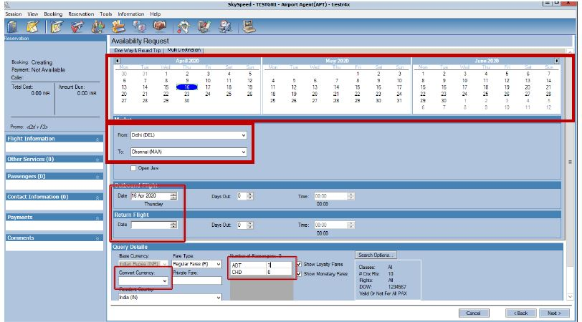

Slide 14
F4: Reserve flight.
Click on Next. The system will go to F4
All flights will appear on the screen from 00:00 till 23:59 in order.
Provide all flight details to customer and ask customer which flight he / she will prefer. Accordingly now click on desired flight.

Slide 16
Identification of flight: Based on the color coding the flight can be identified as follows.
Green–Direct
Blue–Transit
Yellow-transfer
Any flight with O Red circle the flight is full and cannot be booked.

Slide 17
Please do not inform the customer the fare reflecting in front of the selected flight as the fare will not include taxes. The fare which reflects in the Amount due will be the correct fare to be charged and we will inform the same to the customer.

Slide 18
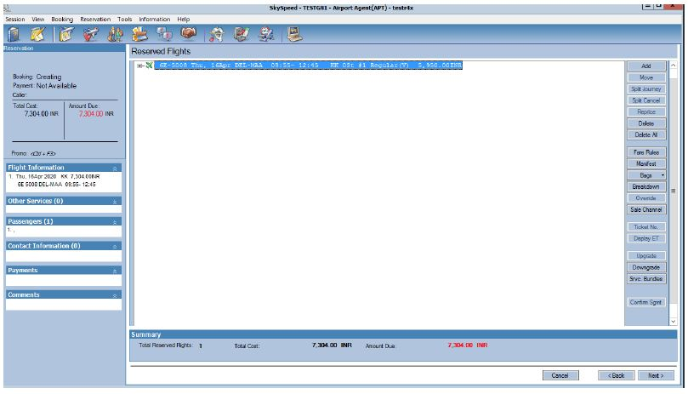
Click on Next the system will go to 2nd page of F4, Where we need to reconfirm the flight selected.

Slide 19
F5: Customer Details
Click on next it will take you to F5.
F5: Customer Details. It will have total 3pages
F5:1stpage we will provide the following information.
•Last name / first name / title
•Any SSR which needs to be added
•Passport details for international flight
•INFT details if customer is travelling with INFT

Slide 20
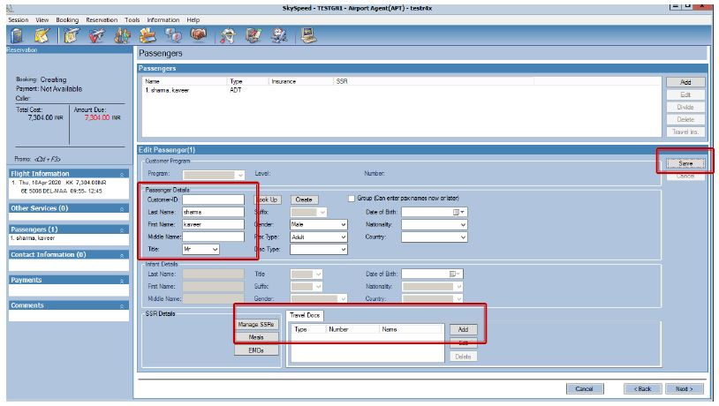

Slide 21
Click on save the system will take you to next page where we need to confirm passenger details and click on next.
F5:2ndpage of F5 will open following details needs to be entered
•Mobile Number
•Email Id
•Click on Do not have GST information if the customer has no GST details

Slide 23
Click on save the system will take you to 3rdpage of F5
F5: 3rdpage seat options. Here should you wish to reserve a seat for customer you can do so. Inform customer charges will be applicable.
Click on seat map and the seat map for the flight will open.
If not then Click on skip.

Slide 24
By clicking on the desired seat of the customer you may select a particular seat please explain the customer charges will be.

Slide 26
F6: Payments
Click on next it will take you to Payments page F6.
F6: Payments
The amount due will reflect in Red
Method of payment:
CA-Cash
CF –Credit file
CS-Credit shell
EA –American express Credit card
ED –debit card
EM –Master Credit card
EN –Maestro Credit card
EV –VISA Credit card

Slide 27
Important: Split payments can be accepted (E.g. If the amount due is INR 5000/-INR 2500 can be accepted in cash and balance INR 2500/-can be accepted by credit card or debit card or credit shell)
Card No. / Date of expiry of card / Manual approval code / Name of the card holder.

Slide 28
For training purpose we will use the following credit cads
EV –4444333322221111 / DOE 12/22 / Approval code 123456

Slide 30
F7: Fare rules
F7:1st Page
The system will show fare rules where we are supposed to explain the customer the following
•Free baggage allowance
•Change and cancellation fee
Click on next the system will take you F7 2ndPage to add comment

Slide 31
F8: End record
Select how the mode of sending the itinerary

Slide 33
Select Next
The system will ask you for the caller’s name and contact details enter the same and click on next.

Slide 35
The PNR will be created

Slide 36
F9: Fees. Following fees can be charged to the customer through F9
Self offload / N move.
F10: For retrieving the reservation / PNR
F11: Flight information ETA /ETD
F12: Log-out

Slide 37
Dividing the PNR
When more than 1 customers are booked in the PNR and one of the customer wants to change the booking due change in travel plan. This option can be used. The divided customer will have a separate PNR. The necessary changes then can be done on the same.
F10 Retrieve PNR / F5 / click on divide / divide booking screen will appear in front / Select the name of the customer who wants to be divided / click on divide / The system will prompt you child PNR will be created / Click on YES……
The PNR will be divided and 2 PNRs will appear

Slide 38
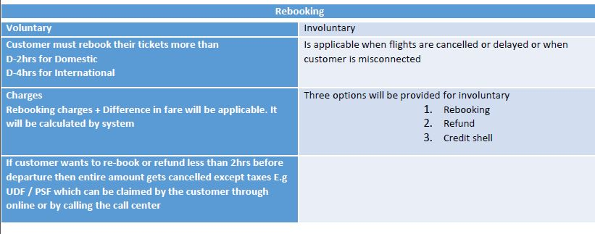
Rebooking:

Slide 39
GoNow: Check-in and Boarding System
The system used for checking-in the customer and make necessary additions during check-in is called as GoNow.

Slide 42
Check-In

Slide 43
Search
•To retrieve Customer by PNR / Flight / and last name
•Security
•Unlock PNR from watch queue
•Add travel document for international travel
•Seats
•Assign seat
•Change seat
•Bags
•Add and remove bags
•Edit weight

Slide 44
Services
•Adding SSR and fees
•Viewing current SSR
•Payments
•Charging payments
•View existing payments
•Finalize
•Save changes to PNR
•Complete check-in
•Reprint Boarding pass and Bag tag
•Uncheck/offload the customers

Slide 45
Search PNR: This is the first step in check-in. Following 2 options are available for searching the PNR
Quick search –PNR for flight departing in next 8hrs can be searched hear
Advance search –PNR for flights departing up to next 48hrs can be searched.

Slide 46
This customer is not checked in. Press enter or click on next.

Slide 47
The page will go to F3 Security. If the customer is booked on international flight or is booked in watch queue DFNS / SR. Citizen

Slide 48
The next page will be F4 seats
If Seats are pre-booked by the customer this page will be skipped by the system and will directly go to Baggage
However if seats are not pre assigned to the customer then the seats should be assigned.

Slide 49
If you select any premium seat the system will automatically calculate the charges
All SSR will be displayed on the right side of the screen

Slide 50
Press Enter the system will go to F5 Baggage
The system will display the free baggage allowance (FBA)
Enter number of Pieces and weight of each bag individually. Press Enter

Slide 51
The system will calculate excess bag and will reflect the amount.
Press Enter the system will take you to Payment page F7

Slide 52
Until and unless the payments are clear the check-in cannot be completed.
•In the payment history the mode of payment used for purchasing the ticket will appear. This can be used for check

Slide 54
Following details will be displayed on the screen.
•Flight details
•Passenger details
•Comments for the customer

Slide 55
The system will take you to F10 Finalize check-in. The following 2 options can be performed.
•Check-in passenger -The customer will get checked-in and the boarding card and baggage tag will be printed.

Slide 56
Flow of Process
F2: Search
This key/page is to retrieve a PNR or use Advance search to search for an outdated or future reservations.
F3: Security
Flow to clear watch queue
Flow to enter passport
F4: Seat
Customer may request to change seat after web check-in / KIOSK check-in
Enter / Add baggage PC & WT
Enter / F10 Finalize / Check-in passenger -Enter

Slide 57
Departure
Departure
To shift from Check-in to Departures Alt + R / Ctrl + F2
F2: Departure page
It will provide the following details:
1.Flight status in symbol
2.Flight No.
3.Sector
4.Date of operation
5.STD / STA / Gate No.
6.Status of the flight (On-time / Delayed / Boarding / Cancelled
7.Total seats sold on the flight / Number of customers checked-in for the flight / No-Show customers

Slide 59
Following activities can be done in Departures:
1.Closing and finalizing the flight
3.Check the flight summery and overview (Total customers booked on the flight/ checked-in/ No-Show / / Boarded Etc.)
4.Generate report and manifest
5.Boarding process

Slide 60
Ok to board: Green Response
F5: Boarding
The scanner will be attached to Go Now. Staff will scan the boarding pass and will see the responses on the screen.

Slide 61
Ok to board but pay attention: Yellow response the reasons mentioned below
1.Customers with SSR: UMNR / WCHR / MAAS / Extra seat / BLND / DEAF / INFT
2.Customer seated on emergency exit row (check for eligibility criterion)
3.Watch queue customers
4.Customer travelling on Jump seat

Slide 62
Do not board the customer: Red Reasons mentioned below
1.Customers boarding wrong flight / Wrong date
2.Duplicate boarding pass / Duplicate customer boarding

Slide 63
Important: Stop these customers from boarding.

Slide 64
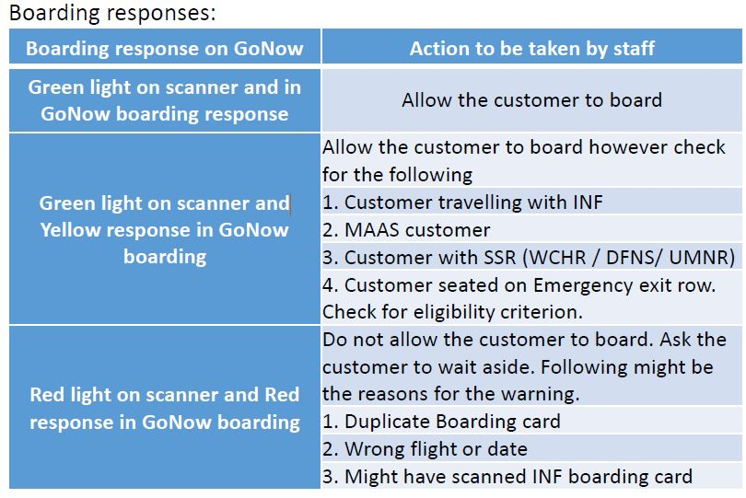

Slide 65
WORKSHEET
1.Draw the flow chart of Go Now check-in Procedures.
2. Elaborate the various scanner responses at the boarding gate.
3. Explain each functions of Sky speed software and its purpose.
4. Discuss the factors that airlines should consider when designing user interfaces for systems like Go Now to ensure a seamless and intuitive bag addition and checkout process for passengers.

Slide 66
Applications
The student will come to know about the various terms used at the airport
The student will explain about the various polices followed at the airport
To understand the terms specific to aviation sector
Develop the basic knowledge-based on airport operations
To understand the basic concepts of aviation

Slide 67
REFERENCES
Text Books / Reference books
Text Books
T1 "Airport Operations, Second Edition" by Norman J Ashford and John W Dixon
T2. "Airport Engineering: Planning, Design, and Development of 21st Century Airports" by Norman J. Ashford and Stuart D. Waite
Reference Books
R1. “Airport Terminals: Butterworth Architecture Library of Planning and Design Kindle “Edition by Christopher J. Blow (Author) Format: Kindle Edition
R2. AIRPORT PLANNING AND MANAGEMENT 6/E Paperback – 16 May 2011, By Seth Young (Author), Alexander T. Wells (Author)

Slide 68
Assessment Pattern
 |  | Theory |  | Practical
Components | Internal Assessment | Mid Term Assessment | End Term Assessment | Continuous Assessment | Mid Term Assessment | End Term Assessment
Marks | 40 |  | 60 | 60 |  | 40
Total Marks | 100 |  |  | 100

Slide 69
THANK YOU

